Slide 1
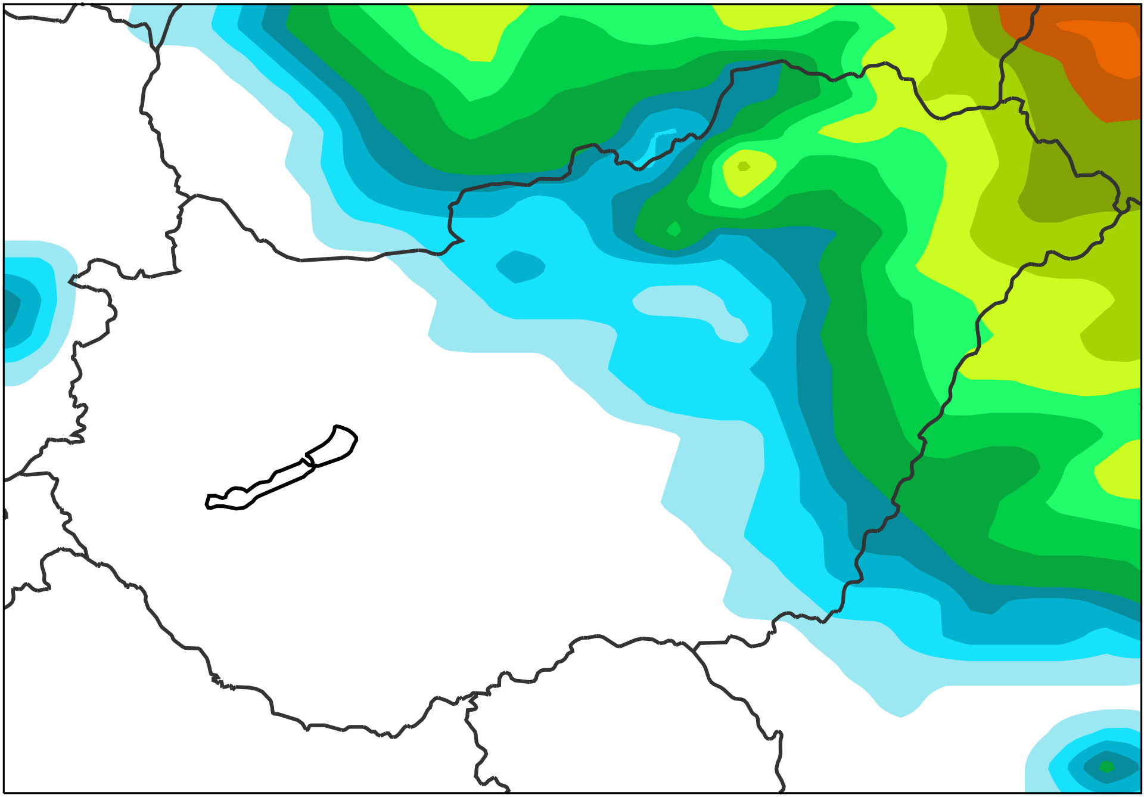
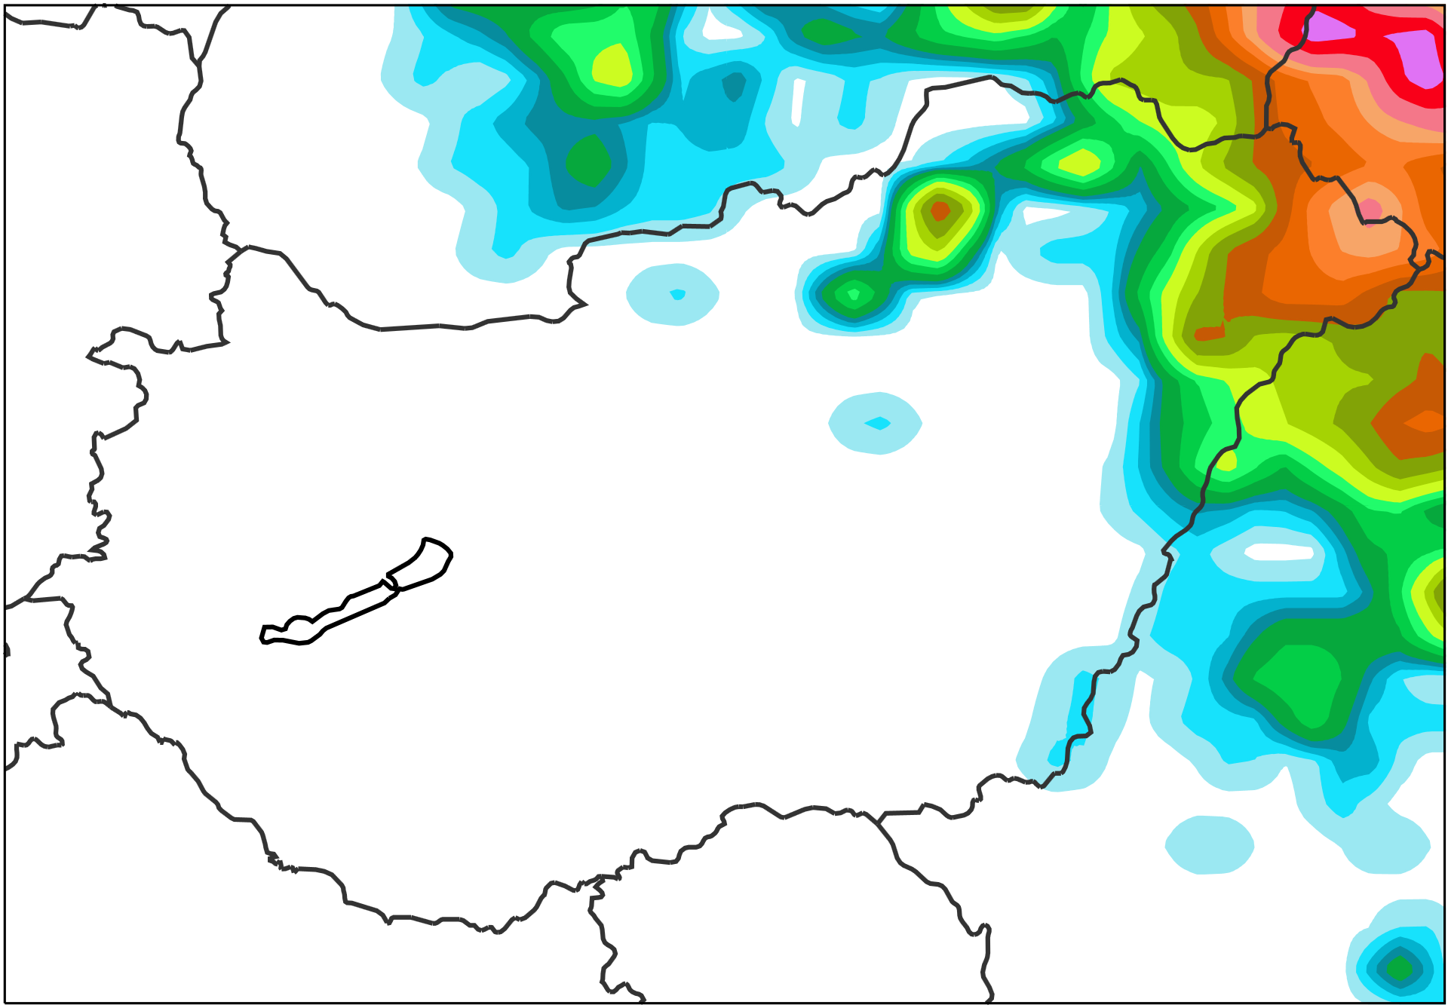
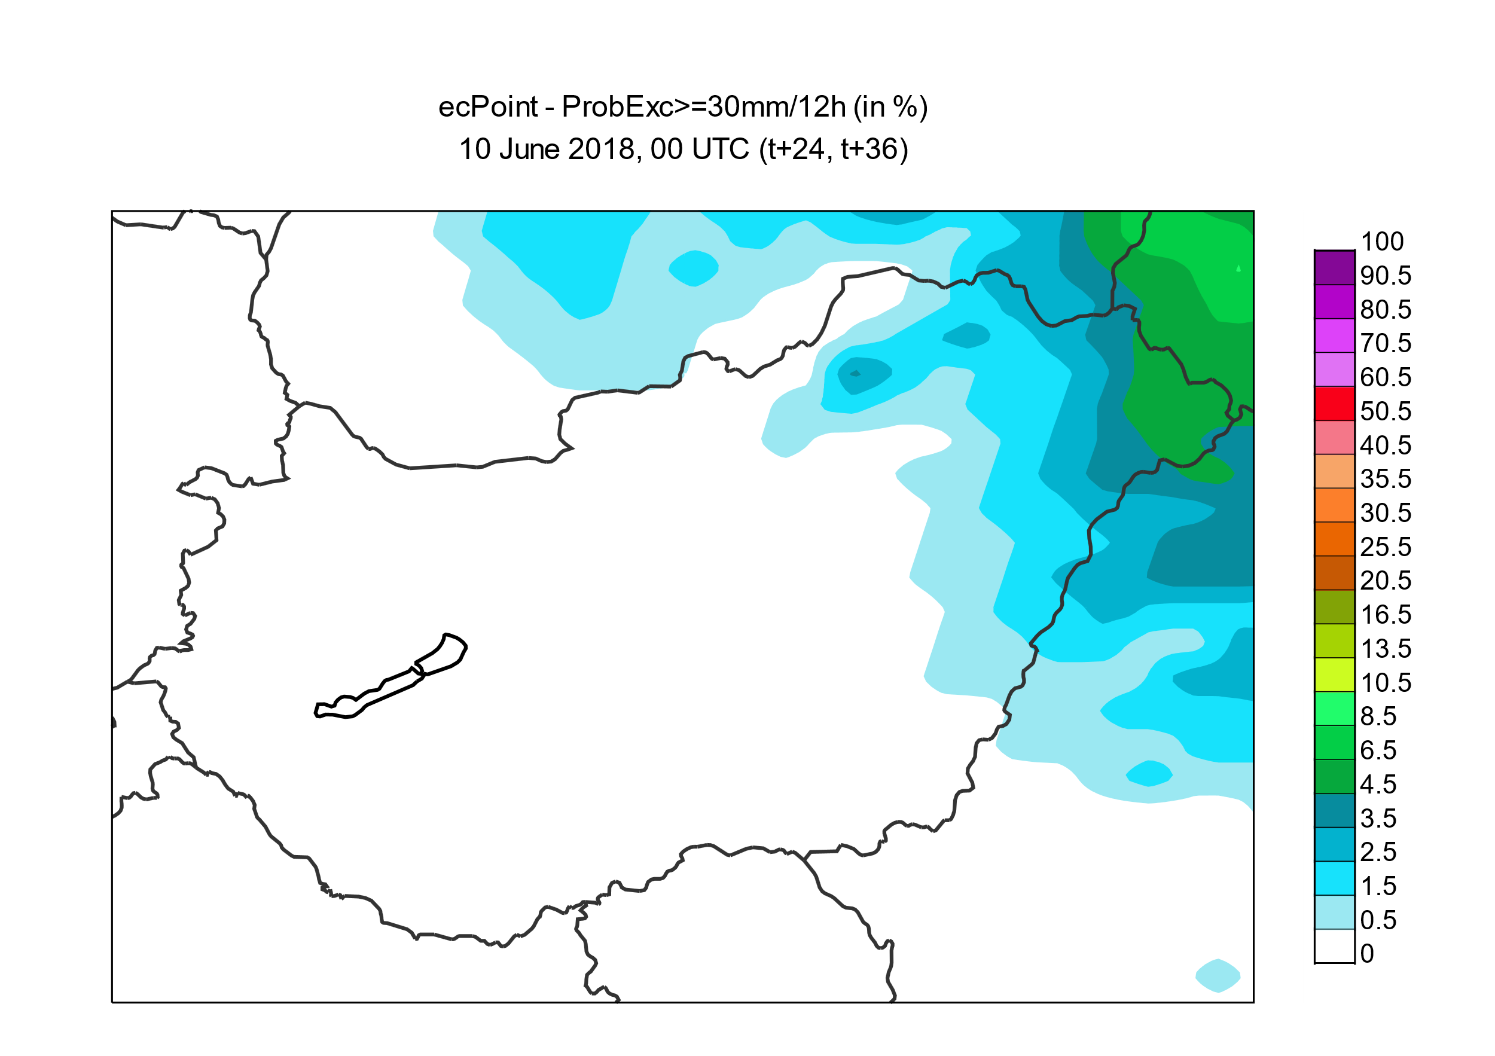
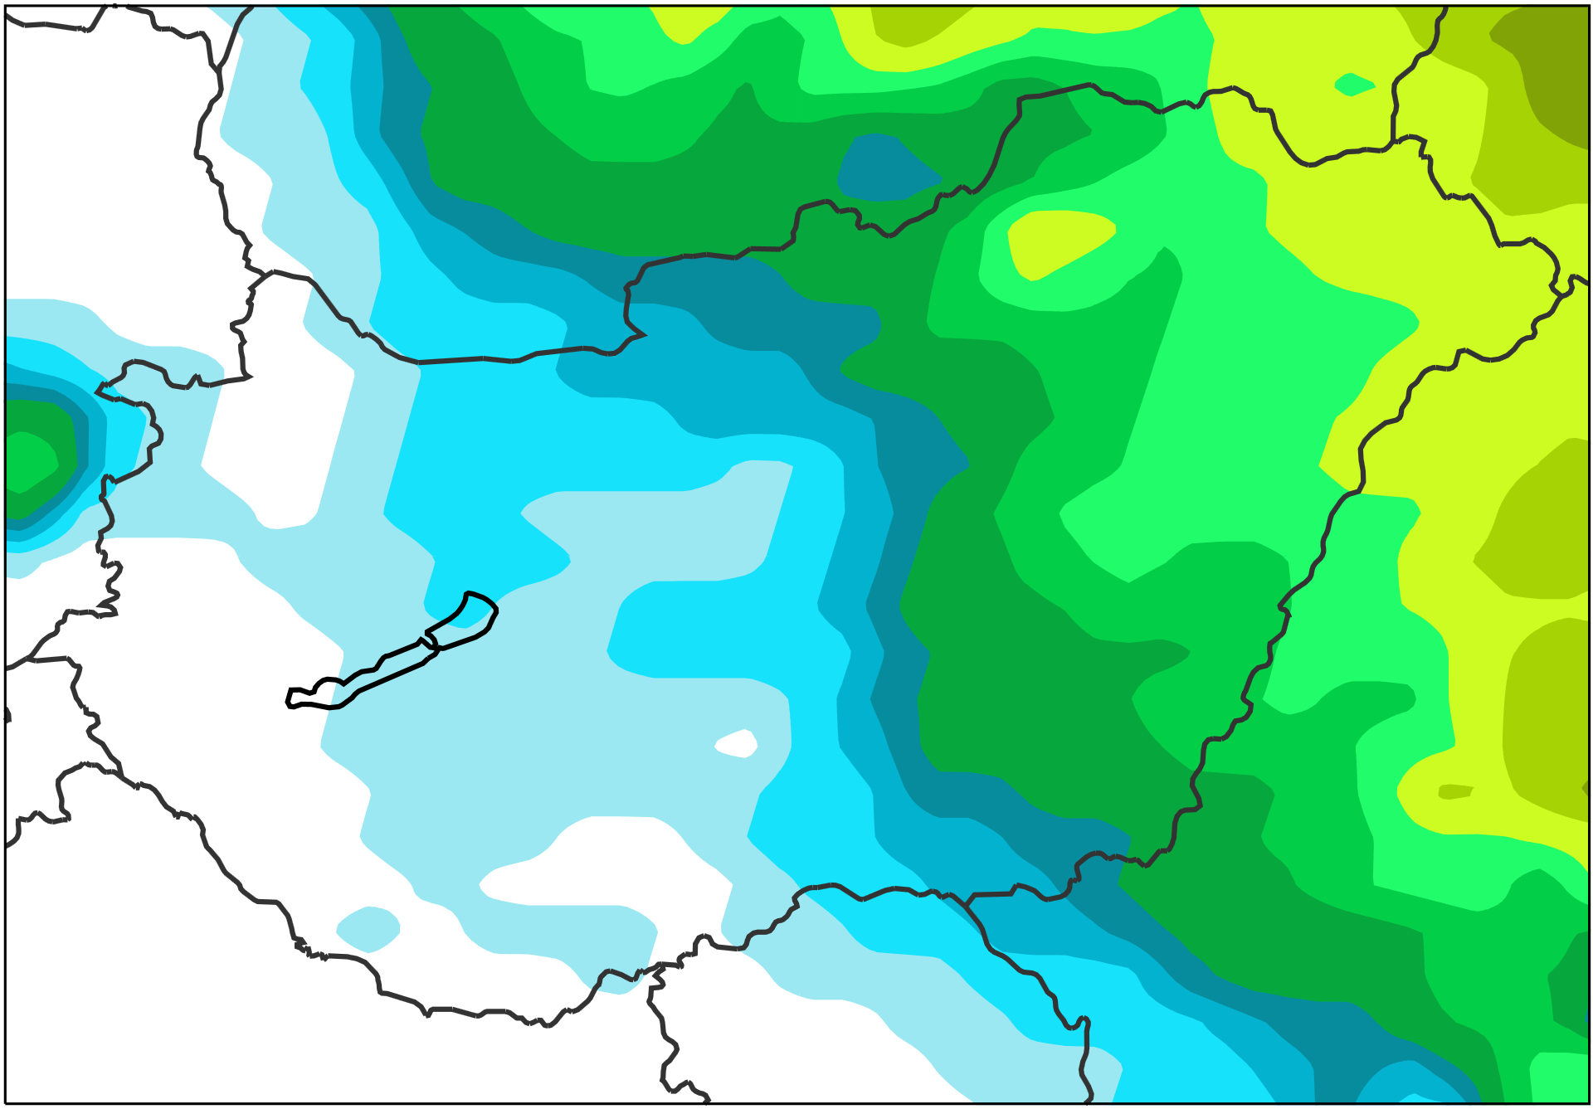
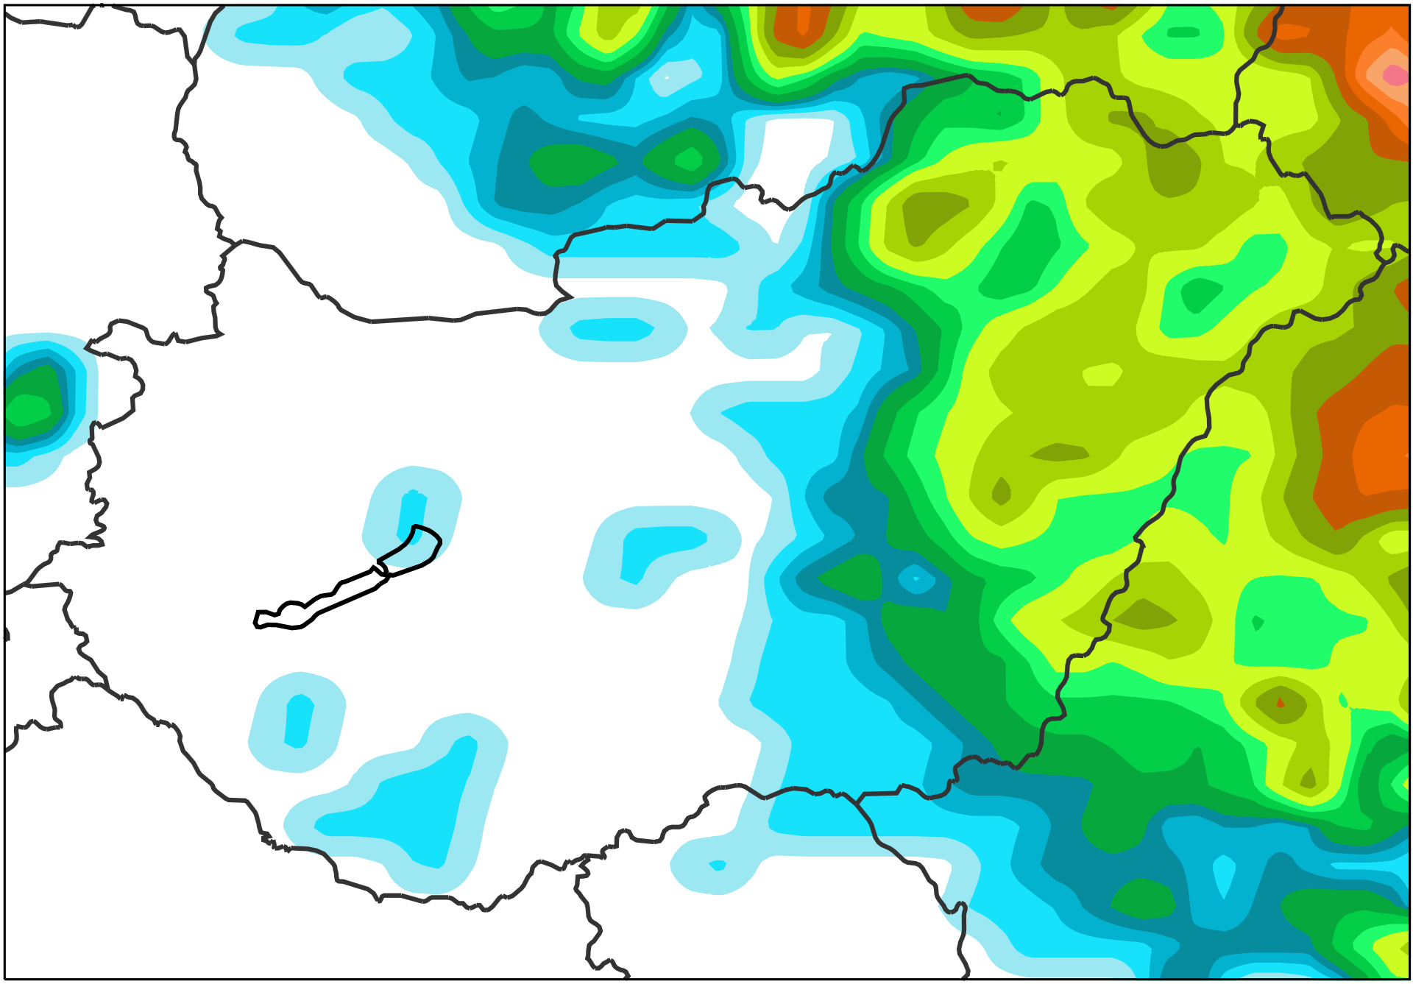
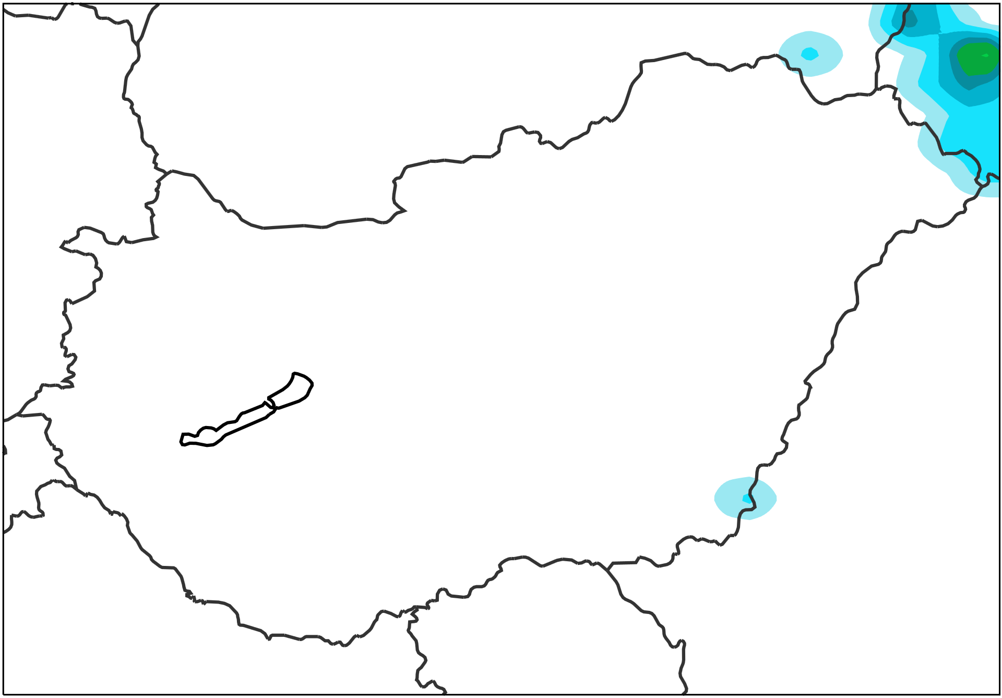
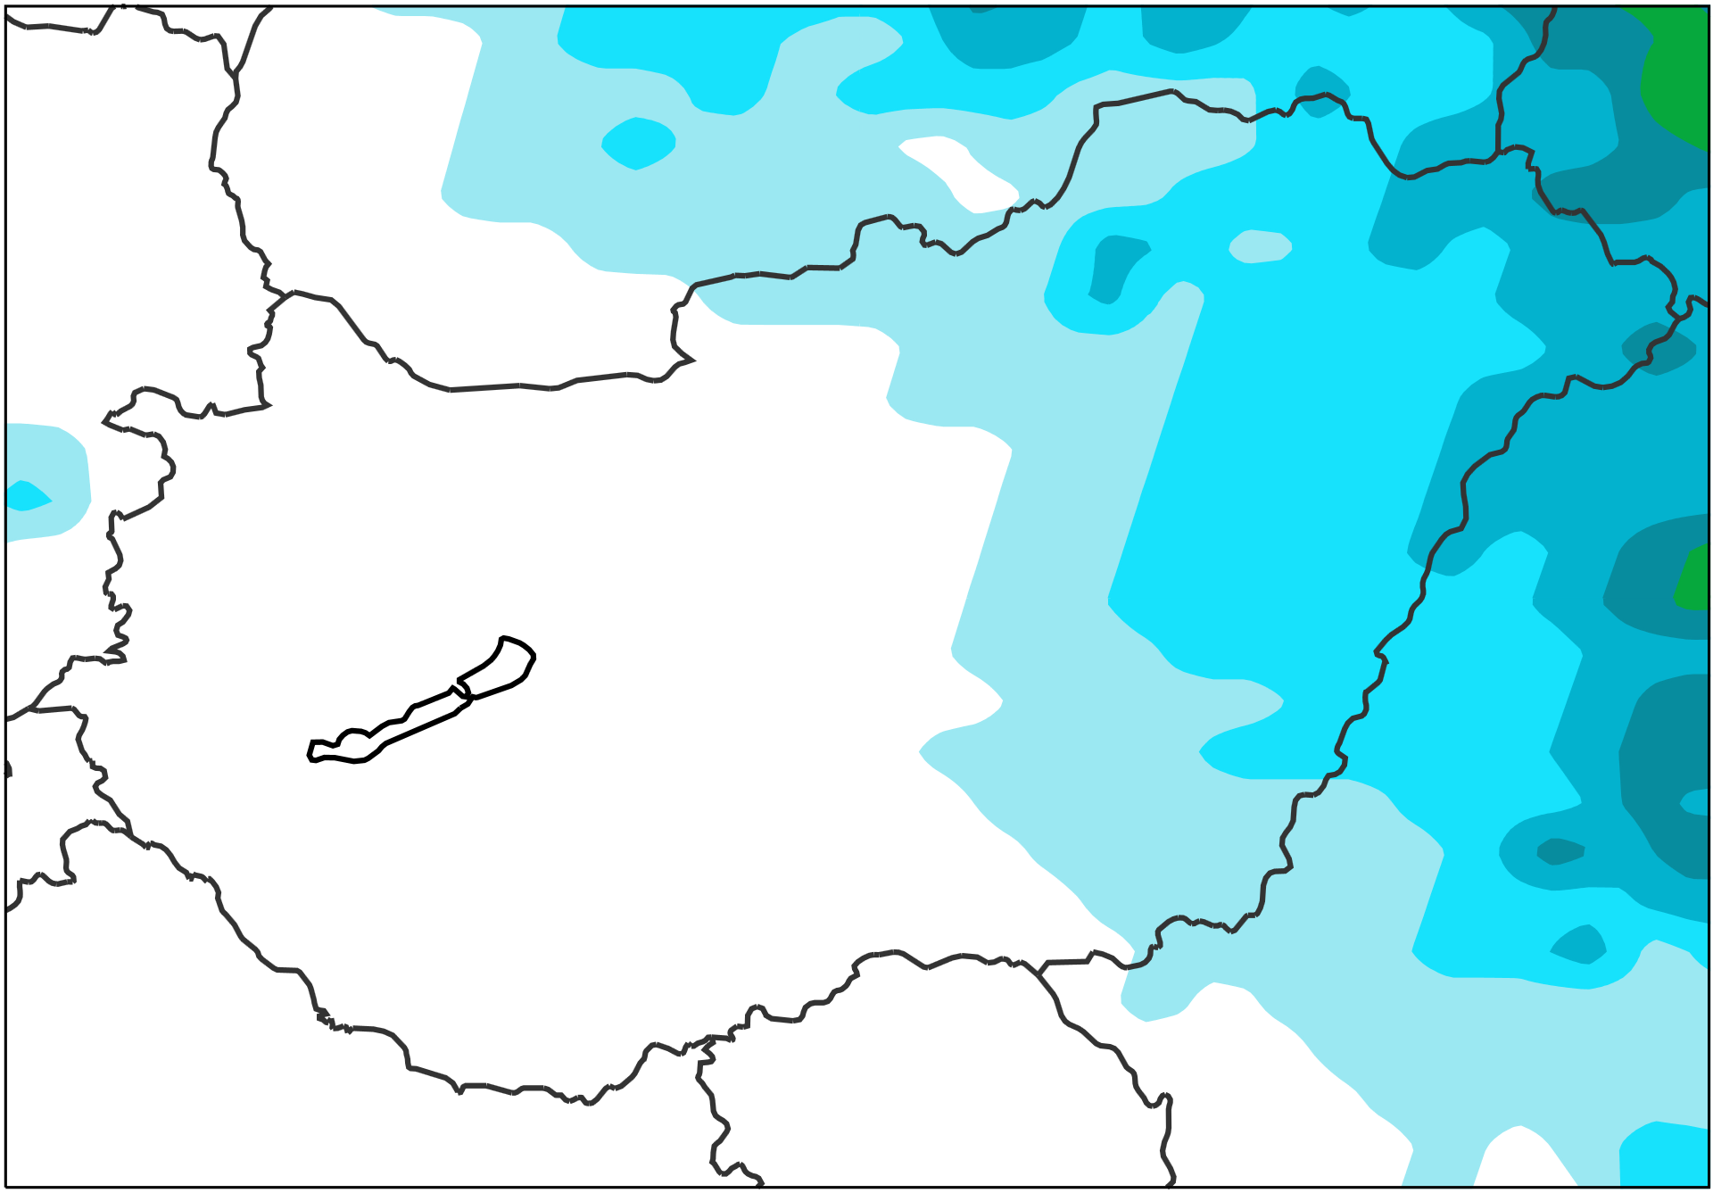
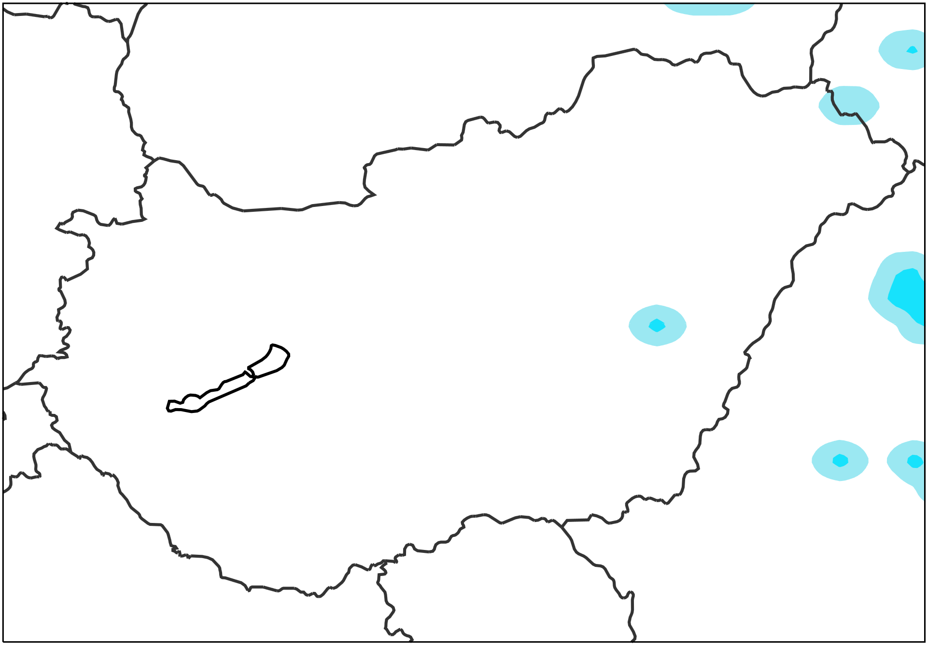
Probabilities of not exceeding 10 mm /12h
VT: 2018/06/11 00 UTC to 2018/06/11 12 UTC
ecPoint – Rainfall
Raw ENS
AROME (2.5km, OMSZ)
Would be nice to have.
2018/06/10 00 UTC
(t+24,t+36), DAY 2
[%]
2018/06/08 00 UTC
(t+72,t+84), DAY 4
Probabilities of not exceeding 30 mm /12h
VT: 2018/06/11 00 UTC to 2018/06/11 12 UTC
ecPoint – Rainfall
Raw ENS
AROME (2.5km, OMSZ)
Would be nice to have.
2018/06/10 00 UTC
(t+24,t+36), DAY 2
2018/06/08 00 UTC
(t+72,t+84), DAY 4

